Slide 1
Presentation on
Vehicle number plate dETECTION using Android
TEAM MEMBERS
MRUDULA MYTHRI RAGIDIMILLI
USHA RANI GORIJALA
DURGA DEVI CHEEPURIPALLI
SATYA GAYATHRI PADALA
SATYA DEEPTHI MUDUNURI
Under the Esteemed Guidance of:
Mr. S.V.KRISHNA REDDY,M.TECH.

Slide 2
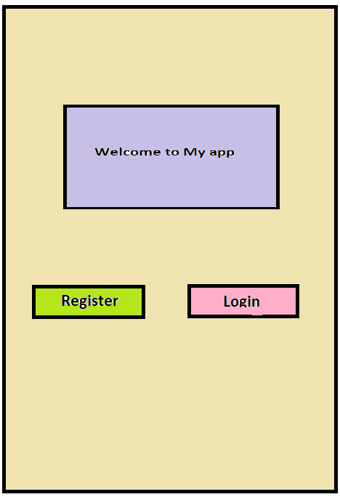

Slide 3
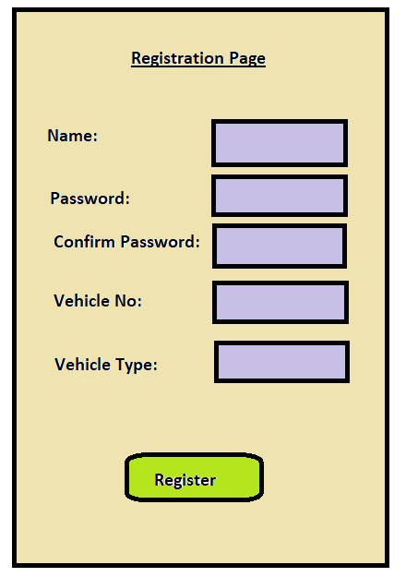

Slide 4
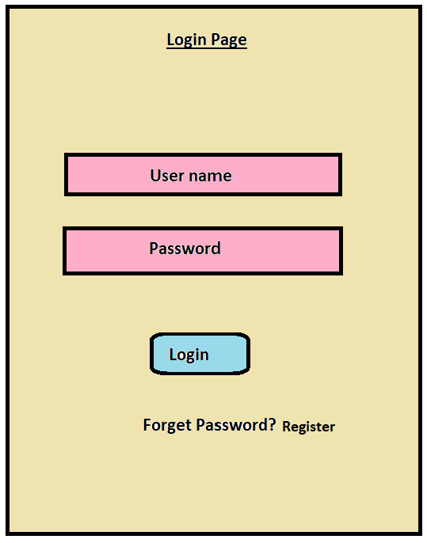

Slide 5
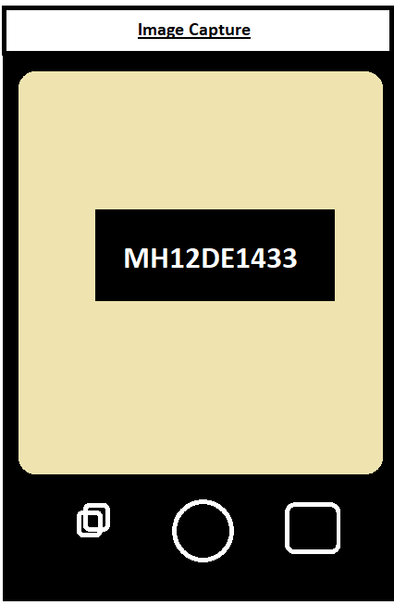

Slide 6
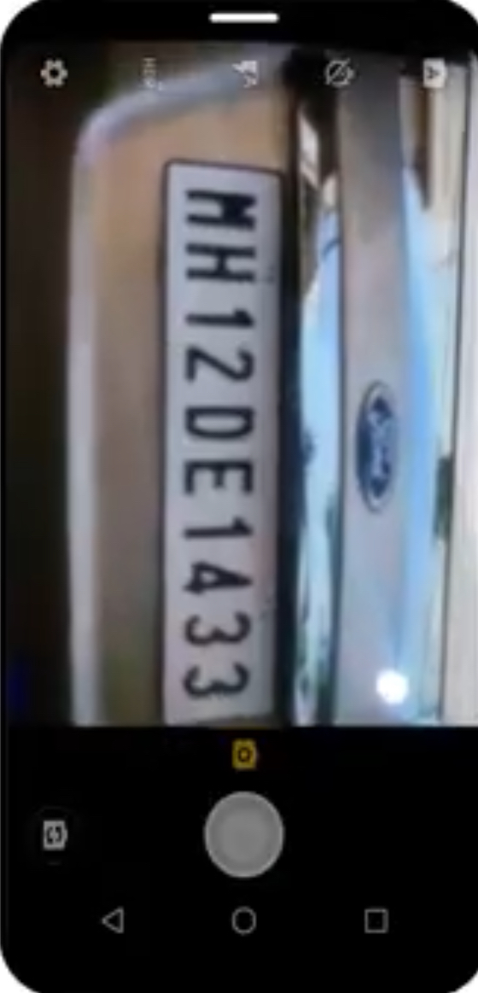

Slide 7
Thank You

